Slide 1

ML Performance for flow
LDA-c vs Spark LDA
Apache Spot, December 2nd, 2016
Prepared by: Gustavo A. Lujan

Slide 2
Straight to the point

Slide 3
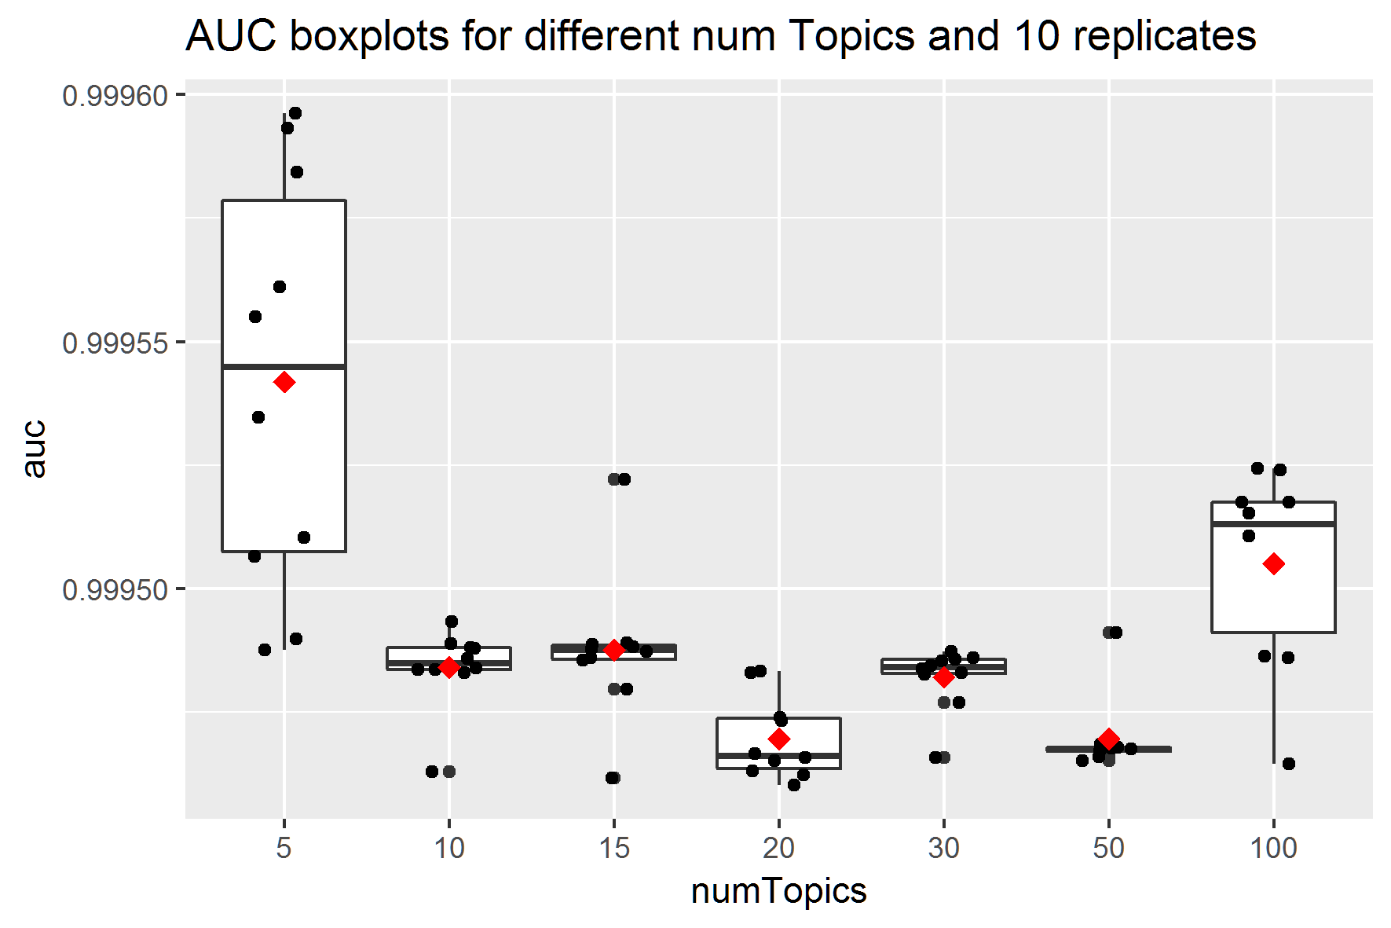
Boxplots Spark-LDA
Weird behavior regarding performance by numTopics.
numTopics=5 shows the best average performance but the worst stability.
numTopics=20 has one of the lowest performances in terms of AUC.

Slide 4
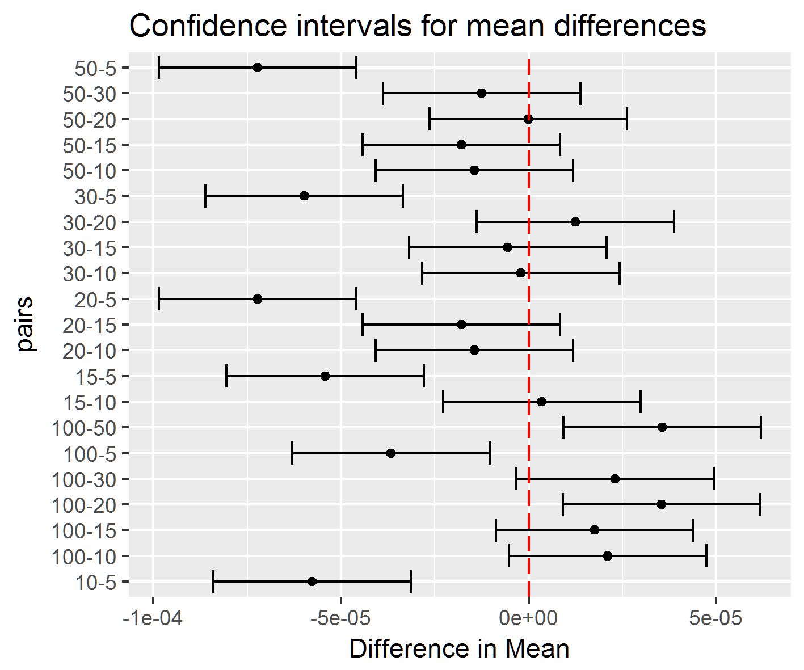
Boxplots Spark-LDA
numTopics=5 level is significantly different from the rest.
There are no significant difference in the rest of the levels.
This means that if we run numTopics = 10 or 100 we get the same results.

Slide 5
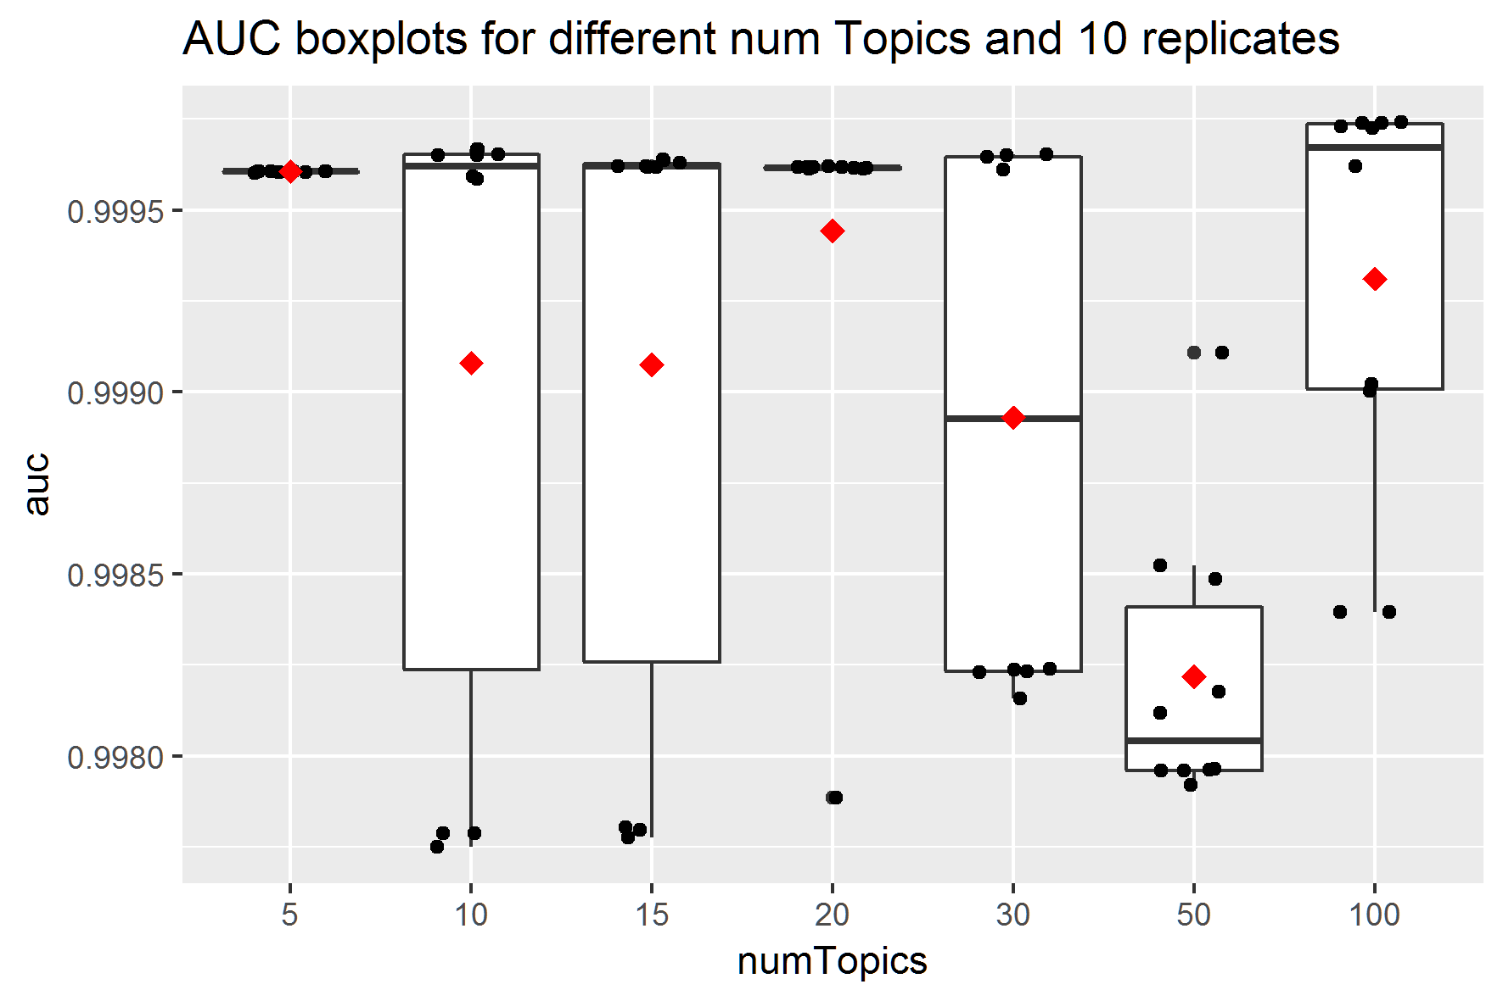
Boxplots LDA-c
LDA-c has also an interesting pattern.
numTopic=5 seems to have the best performance in terms of average and dispersion.
numTopic=50 has the lowest performance.
Overall the central tendency seems to be the same across levels.

Slide 6
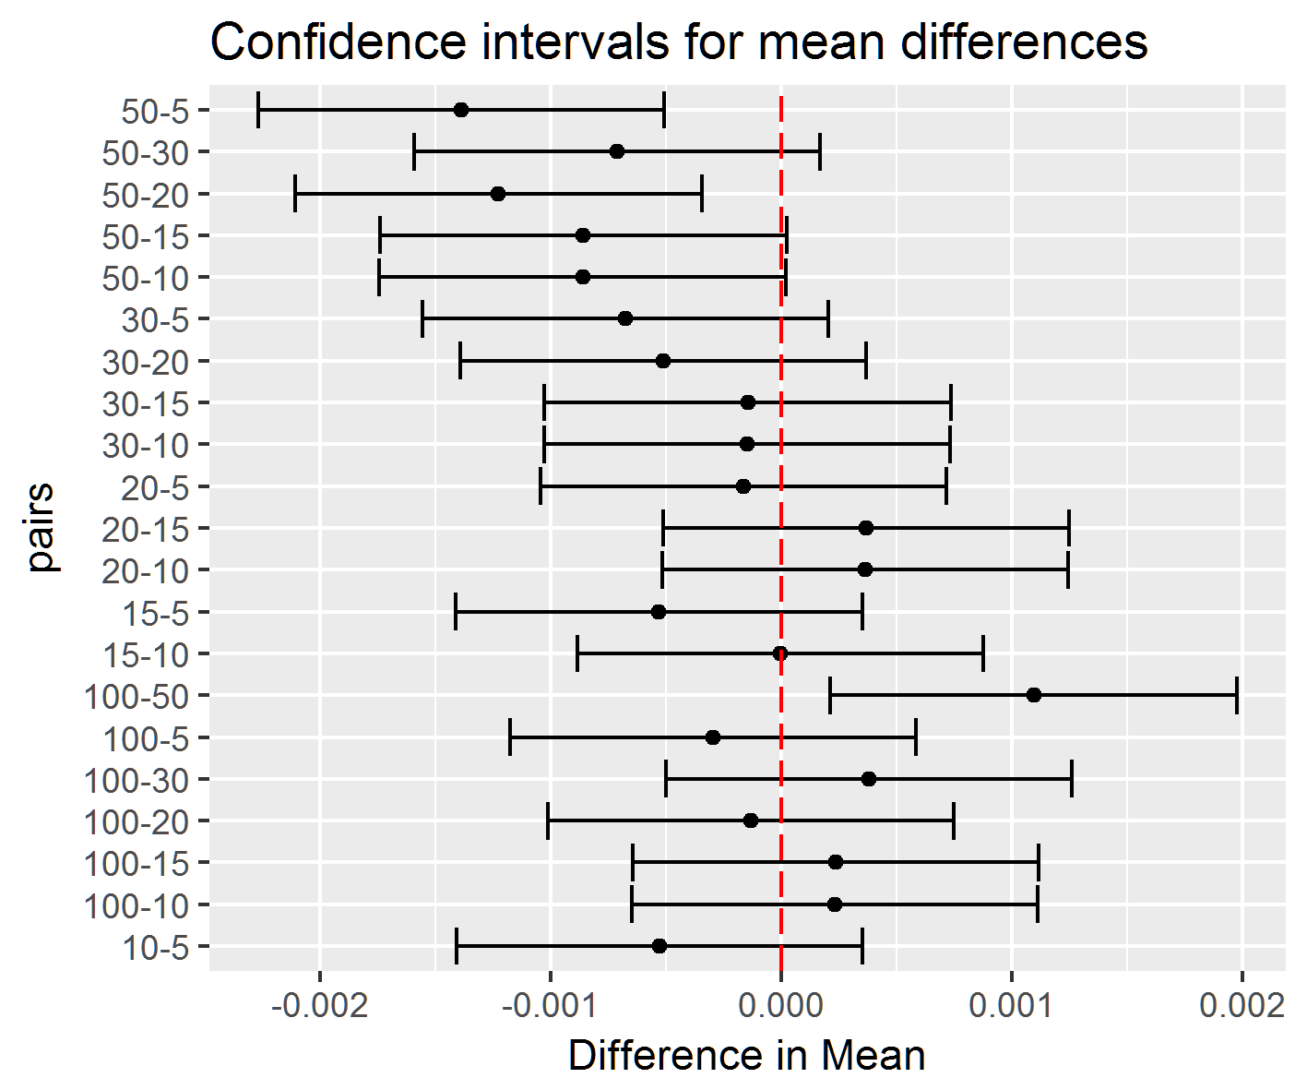
Boxplots LDA-c
As a matter of fact only the pairs (50,5), (50,20) and (100,50) are significantly different.
There are no significant difference for the rest of the levels.

Slide 7
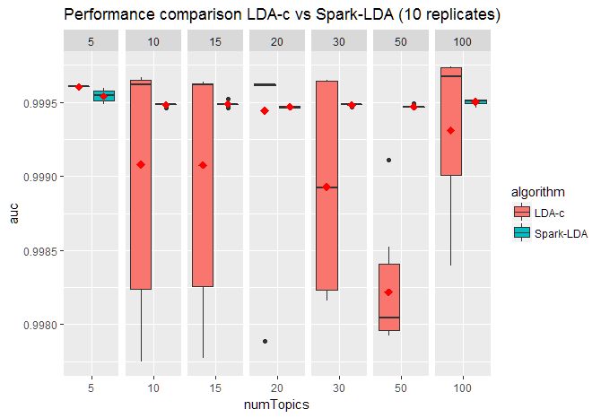
Boxplots
Side by side Spark-LDA seems to be a better option in terms of average performance and stability.
Variation is too high for LDA-c when compared to Spark-LDA.
Maybe this is due to the optimizer used. LDA-c uses variational EM while Spark-LDA uses the approach followed by Asuncion et al. (2009).

Slide 8
Two-sample t-test
We performed a two-sample t-test for mean differences for each of the numTopics.
The only significant difference was found at numTopic=50 (p<0.001).(See results from R at the end of the presentation)
This means that at numTopic=50 Spark-LDA performs significantly better than LDA-c. For the rest there is no significant difference.
Large variation of LDA-c does not allow to find more significant differences.

Slide 9
Conclusion
Spark-LDA seems to perform at least as good as LDA-c in terms of AUC.
The only significant differences were found at numTopic 50.
Spark-LDA provides better stability, possibly due to the optimizer used to find the parameters.
In terms of time, Spark-LDA took 23:30 (h:mm) to run 70 replicates and LDA-c took 23:20 (h:mm) to run the same quantity. The dataset was ~318 billion records.

Slide 10
2-sample t-test for numTopic = 50
[1] "Significant differences in numTopic = 50"
Welch Two Sample t-test
data: ldac$auc and spark$auc
t = -10.334, df = 9.0072, p-value = 2.703e-06
alternative hypothesis: true difference in means is not equal to 0
95 percent confidence interval:
-0.0015255681 -0.0009776685
sample estimates:
mean of x mean of y
0.9982180 0.9994696

